Slide 1

Succession to Value™
Dubai, January 2026

Slide 2





Succession to Value™ learning objectives
At the end of this program, participants will:
Explain the differences between traditional succession planning approaches and the T2V Succession Planning process
Identify future-focused Jobs to be Done for key roles to assist in selecting the best successors
Complete a risk assessment and identify superpowers needed to deliver value from critical roles
Prepare outputs (succession readiness assessment, role health snapshots, externally-benchmarked readiness assessments, Hogan report) to assist with successor selection
Build targeted succession mobilization plans

Slide 3

Agenda
AM | /DEFINE Future Jobs to Be Done (Activity) Risks and Superpowers (Activity)
PM | /ASSESS Multi-Point Evidence Mosaic (Fact-based) Determine Succession Readiness /MOBILIZE Succession Development Plan (Activity)

Slide 4


The business case for Talent to Value™
WHAT are the challenges?
WHY is the Talent to Value concept important in today’s business context?
Unsuccessful transformations
Risks with moving too fast
“My organization is not talented enough”
Faster delivery of business strategy
Greater alignment of senior team
Clarity and accountability
Ensuring Talent is set up for success
Differentiated routines and focus on work and roles that matter the most
Emphasizes risk-seeking to help identify the best fit for the future needs of the role

Slide 5
Succession to Value™

Slide 6

Succession to Value™
40%
of external executive hires fail within the first 18 months ¹
66%
of executives say that hires are not fully prepared ²
71%
PE CEOs are replaced sometime during the hold period ³
86%
of leaders do not feel confident in their succession plans ⁴
2-10X
the annual salary can be the cost of a failed VP or CEO hire ¹
Data source:
Millman Search, 2025
Deloitte, 2025
HBS, 2022
Deloitte, 2018

Slide 7
Succession to Value™ pivots
Traditional Approach
Succession to ValueTM Pivot
Succession for Status Quo
Assume today’s role & results are valid for the future
Future-Focused Outcomes (Jobs to be Done)
Alignment on specific, future-focused outcomes successor must deliver
Competencies
Assess/Project how successors will perform in generic leadership competences without business context
Superpowers
Identify few critical superpowers in overcoming risk, and assess for evidence that shows the candidate can deliver value
Succession Readiness Is Broad
Static view of the job & development over many years promotes a greater number of successors
Succession Readiness More Precise
Given time-bound outcomes, succession readiness limited to those ready-now or those ready with short-term development
Development Builds Better Leaders
Plans include activities and resources to build overall leadership competencies connected to many roles
Targeted Development Closes Readiness
A personalized development plan that prepares successor to perform against future outcomes in a target role @ specific time
Notes:
Animated

Slide 8



Succession to Value™
Why does this matter?
Selecting the wrong person has negative downstream impacts
Job of the future ≠ NOT today’s job
Organizations cannot afford preparing the candidate for outdated expectations
Unsuccessful succession planning often wastes massive resources with months of review meetings, with very limited measurable results

Slide 9
Succession to Value™
Overview

Slide 10


Succession to Value™ methodology
/DEFINE
/ASSESS
/MOBILIZE
What needs to be true in the future for the role to succeed?
Are successors ready for the job? How ready are they?
How do we prepare and support the successor?
Outputs:
Future Jobs to be Done
Risk Assessment
Superpowers
Outputs:
Multi-point Evidence Mosaic
Readiness Summary
Pipeline Health Snapshot
Outputs:
Development Plan
Notes:
Swap icons w/16

Slide 11
Succession to Value™
/DEFINE

Slide 12


Succession to Value™ methodology
/DEFINE
/ASSESS
/MOBILIZE
/DEFINE
/ASSESS
/MOBILIZE
What needs to be true in the future for the role to succeed?
Are successors ready for the job? How ready are they?
How do we prepare and support the successor?
Outputs:
Future Jobs to be Done
Risk Assessment
Superpowers
Outputs:
Multi-point Evidence Mosaic
Readiness Summary
Pipeline Health Snapshot
Outputs:
Development Plan
Notes:
Swap icons w/16

Slide 13

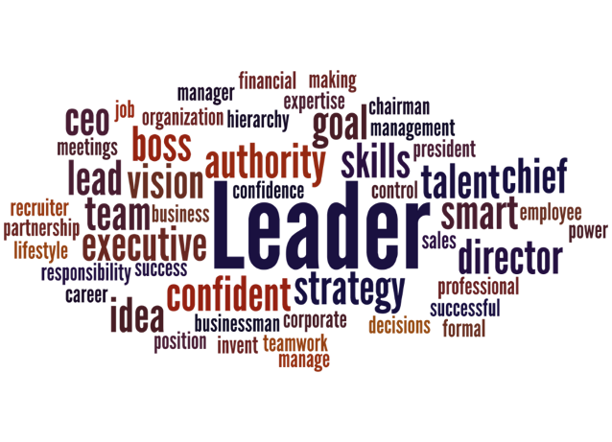
Job descriptions vs Jobs to be Done
/DEFINE
/ASSESS
/MOBILIZE
Job Descriptions
JOBS TO BE DONE (JTBDs)
Describes Responsibilities
No Context
Actions and Outcomes
Linked to context and strategy
The Succession Planning process requires future-focused JTBDs

Slide 14



Building future Jobs to be Done
/DEFINE
/ASSESS
/MOBILIZE
FUTURE JOBS TO BE DONE
That reflect:
Organizational goals in the near future
Strategic pivots (expansion, acquisition, transformation)
OUTCOMES
KEY WORK
MEASURES
What
How
How Much &
By When
What are the 3-5 things that would
have to be true for the value to arrive?
What are the critical actions for each JTBD to answer, “What should be done?”
What are the critical outcomes for each JTBD
to answer, “How to measure the success?”
When must the JTBD be achieved for
the value to arrive?

Slide 15

Future-focused jobs to be done
/DEFINE
/ASSESS
/MOBILIZE
Succession Planning requires future focus and an understanding of organizational strategy and pivots
Geographic pivots
Presence pivots
US
Global
B&M
Hybrid/digital
Growth pivots
Structural pivots
Organic
M&A
BU
Product
Pivot Examples

Slide 16
Example - future jobs to be done
/DEFINE
/ASSESS
/MOBILIZE
The Pivots
Decentralized portfolio maintenance
Centralized portfolio management
Siloed, Rx‑centric analytics
Integrated therapeutic insights
Traditional marketing
Unified digital insight-and-activation engine
FUTURE JOBS TO BE DONE
HOW MUCH
WHAT
Drive Big Brand Scale Up to generate an additional $150M by
Creating four new mega brands and doubling the $25M+ brands by 2027
Better therapeutic insights
PLC management of Big Brands
Strengthen the branding process by expanding digital insight capabilities beyond the current Rx capabilities
Reducing A&P spend on the base portfolio by 2%
BY WHEN
HOW

Slide 17
Example – what does good look like
/DEFINE
/ASSESS
/MOBILIZE
Role: Head of Digital Solutions & Data
# | Wt% | Outcome | Priority Work
1 | 30% | Continuous Improvement of Infrastructure | What: Strengthen digital/data infrastructure so SuperApps, payments, and vertical platforms run reliably across five markets. How: Modernize Tier‑1 stacks; deploy SRE/AIOps, SIEM/SOAR, and standardized incident/change playbooks; enforce data residency, payments, and privacy controls; automate capacity and release validation. How much: Full compliance on audited systems; reduce unplanned downtime by 50%. By when: 31 Dec 2027.
2 | 35% | Digital Transformation of Core Processes | What: Reengineer core workflows (onboarding, payments, merchant/agent networks, clinical flows) to remove manual handoffs and speed delivery. How: Implement API-first, event-driven integrations, RPA for repeatable tasks, standardized data contracts, and automated reconciliation and observability. How much: $100M+ efficiency gains; digitize ≥70% of critical workflows. By when: 31 Dec 2028.
3 | 15% | Digital Innovation for New Products, Services, and Revenue Streams | What: Productize AI1440 and data capabilities into revenue-generating products across fintech, entertainment, healthcare, and education. How: Co-design with vertical and country teams, build compliant MLOps and data pipelines, localize LLMs, and scale pilots through product management and measurable monetization metrics. How much: Enable $50M+ new revenue; launch ≥10 products. By when: Revenue by 31 Dec 2028; launches by 31 Dec 2029.
4 | 20% | Major Platform & Technology Upgrade | What: Deliver major platform upgrades (SuperApp core, payments hub, identity, health stores) without disrupting customers or compliance. How: Use phased migrations, canary releases, validation testing, and disciplined change governance balancing central standards and local needs. How much: Complete 3 major upgrades with ≥95% on-time/on-budget delivery and <5% transition disruption. By when: 31 Dec 2028.
Ensure SuperApps, payments, and vertical platforms run reliably across five markets by strengthening digital and data infrastructure. Modernize Tier‑1 stacks and deploy SRE/AIOps, SIEM/SOAR, and standardized incident/change playbooks while enforcing data residency, payments, and privacy controls and automating capacity and release validation. Achieve full compliance on audited systems and reduce unplanned downtime by 50% by 31 Dec 2027.
Reengineer core workflows—onboarding, payments, merchant/agent networks, and clinical flows—to remove manual handoffs and accelerate delivery. Implement API-first, event-driven integrations, RPA for repeatable tasks, standardized data contracts, and automated reconciliation and observability to drive change. Deliver $100M+ in efficiency gains and digitize ≥70% of critical workflows by 31 Dec 2028.
Productize AI1440 and data capabilities into revenue-generating products across fintech, entertainment, healthcare, and education by co-designing with vertical and country teams, building compliant MLOps and data pipelines, localizing LLMs, and scaling pilots through product management and monetization metrics. Enable $50M+ of new revenue and launch ≥10 products, with revenue by 31 Dec 2028 and launches by 31 Dec 2029.
Deliver major platform upgrades (SuperApp core, payments hub, identity, health stores) without disrupting customers or compliance by using phased migrations, canary releases, validation testing, and disciplined change governance that balances central standards with local needs. Complete 3 major upgrades with ≥95% on-time/on-budget delivery and <5% transition disruption by 31 Dec 2028.

Slide 18
Example – what does good look like
/DEFINE
/ASSESS
/MOBILIZE
Role: Head of Digital Solutions & Data
# | Wt% | Outcome | Priority Work
1 | 30% | Continuous Improvement of Infrastructure | What: Strengthen digital/data infrastructure so SuperApps, payments, and vertical platforms run reliably across five markets. How: Modernize Tier‑1 stacks; deploy SRE/AIOps, SIEM/SOAR, and standardized incident/change playbooks; enforce data residency, payments, and privacy controls; automate capacity and release validation. How much: Full compliance on audited systems; reduce unplanned downtime by 50%. By when: 31 Dec 2027.
2 | 35% | Digital Transformation of Core Processes | What: Reengineer core workflows (onboarding, payments, merchant/agent networks, clinical flows) to remove manual handoffs and speed delivery. How: Implement API-first, event-driven integrations, RPA for repeatable tasks, standardized data contracts, and automated reconciliation and observability. How much: $100M+ efficiency gains; digitize ≥70% of critical workflows. By when: 31 Dec 2028.
3 | 15% | Digital Innovation for New Products, Services, and Revenue Streams | What: Productize AI1440 and data capabilities into revenue-generating products across fintech, entertainment, healthcare, and education. How: Co-design with vertical and country teams, build compliant MLOps and data pipelines, localize LLMs, and scale pilots through product management and measurable monetization metrics. How much: Enable $50M+ new revenue; launch ≥10 products. By when: Revenue by 31 Dec 2028; launches by 31 Dec 2029.
4 | 20% | Major Platform & Technology Upgrade | What: Deliver major platform upgrades (SuperApp core, payments hub, identity, health stores) without disrupting customers or compliance. How: Use phased migrations, canary releases, validation testing, and disciplined change governance balancing central standards and local needs. How much: Complete 3 major upgrades with ≥95% on-time/on-budget delivery and <5% transition disruption. By when: 31 Dec 2028.
Ensure SuperApps, payments, and vertical platforms run reliably across five markets by strengthening digital and data infrastructure. Modernize Tier‑1 stacks and deploy SRE/AIOps, SIEM/SOAR, and standardized incident/change playbooks while enforcing data residency, payments, and privacy controls and automating capacity and release validation. Achieve full compliance on audited systems and reduce unplanned downtime by 50% by 31 Dec 2027.
Reengineer core workflows—onboarding, payments, merchant/agent networks, and clinical flows—to remove manual handoffs and accelerate delivery. Implement API-first, event-driven integrations, RPA for repeatable tasks, standardized data contracts, and automated reconciliation and observability to drive change. Deliver $100M+ in efficiency gains and digitize ≥70% of critical workflows by 31 Dec 2028.
Productize AI1440 and data capabilities into revenue-generating products across fintech, entertainment, healthcare, and education by co-designing with vertical and country teams, building compliant MLOps and data pipelines, localizing LLMs, and scaling pilots through product management and monetization metrics. Enable $50M+ of new revenue and launch ≥10 products, with revenue by 31 Dec 2028 and launches by 31 Dec 2029.
Deliver major platform upgrades (SuperApp core, payments hub, identity, health stores) without disrupting customers or compliance by using phased migrations, canary releases, validation testing, and disciplined change governance that balances central standards with local needs. Complete 3 major upgrades with ≥95% on-time/on-budget delivery and <5% transition disruption by 31 Dec 2028.

Slide 19
/DEFINE
/ASSESS
/MOBILIZE
/DEFINE Activity
Case study - JTBDs

Slide 20

Case study – future jobs to be done
VP of digital marketing & growth
/DEFINE
/ASSESS
/MOBILIZE
Review the case study for FrontierDigitalCo's 2030 ambition and the critical role identified for succession planning.
Write 1 future-focused JTBD per assigned to group
Debrief in large group discussion
Notes:
QR code placeholder – lower right

Slide 21



Jobs to be done summary
/DEFINE
/ASSESS
/MOBILIZE
Key Points
Strategic pivots drive successful succession planning
JTBD are the 3-5 value-creating outcomes for the role and must be future-focused – otherwise we risk selecting status quo successors who may not be prepared to deliver in the years ahead
Focus on “what, how, how much, and by when”

Slide 22


Work, role, talent risks
/DEFINE
/ASSESS
/MOBILIZE
THE ROLE
THE WORK
THE TALENT
FUTURE JOBS TO
BE DONE (JTBD)
The three to five key actions and outcomes that must be delivered by the ROLE•TALENT combination
ROLE RISKS
Evidence collected on four role design features filtered through the lens of the future Jobs to Be Done
TALENT RISKS
Evidence collected on four talent features filtered through the lens of the future Jobs to Be Done
ROLE RISK Critical - Red and Amber
70%
30%
TALENT RISK Critical - Red and Amber

Slide 23
Execution risks
/DEFINE
/ASSESS
/MOBILIZE
WORK
ROLE
TALENT
Alignment: Is there alignment across stakeholders on the JTBDs?
Authority: Does the role have appropriate decision rights to deliver the JTBDs?
JTBD Match: Is there a strong match of skills and experiences to do the JTBDs?
Complexity: Is this an exceptionally complex task to deliver?
Capacity: Are there adequate resources / team capabilities to deliver the JTBDs?
Superpower Match: How well matched is the talent to the
identified superpowers?
New Work: Is the work new to the role, team, or organization?
Resistance: Does the role face any internal or external resistance to deliver the JTBDs?
Winning Track Record: Does the person have a consistent track record of persisting and finding a way to win?
Competitive Intensity: Is there significant external competitive pressure that impacts delivery?
Incentives: Are the incentives appropriately aligned to the scope of the work expected to deliver?
Two-Way Fit: Is there alignment between the individual and org culture, operating environment?
Notes:
Animate one column @ a time (on click)

Slide 24


Superpowers
/DEFINE
/ASSESS
/MOBILIZE
Superpowers needed to:
Execute the Future Jobs to Be Done
Mitigate the Work & Role Risks
GENERIC FIT CRITERIA
SUPERPOWERS

Slide 25
Superpowers
/DEFINE
/ASSESS
/MOBILIZE
Can you assess talent against it?
Customer‑Insight‑Driven Continuous Improver
Demonstrated ability to consistently convert customer insight into validated changes that produce measurable business impact.
Strong improvement mindset

Slide 26

Identifying impactful superpowers
/DEFINE
/ASSESS
/MOBILIZE
To build superpowers, you need…
Work and role risks
Stakeholder insights
Superpowers must…
Be assessed and rated
Future JTBDs
Be validated with evidence
Drive succession decisions

Slide 27
Example – risk assessment and superpowers
/DEFINE
/ASSESS
/MOBILIZE
Role: Head of Digital Solutions & Data
Future Jobs to Be Done
Work Challenge
1​ | 30% | Continuous Improvement of Infrastructure
2​ | 35% | Digital Transformation of Core Processes
3​ | 15% | Digital Innovation for New Products, Services, and Revenue Streams
4​ | 20% | Major Platform & Technology Upgrade
Cross‑market coordination: Align product, platform, country, and regulator stakeholders across five markets under tight governance.
Platform scale risk: Execute technically demanding upgrades to SuperApp core, payments, identity, and AI infra at 100M+ user scale.
Adoption & localization: Drive bundle and product adoption across diverse languages and customer segments.
Regulatory fragmentation: Manage differing payments, data residency, and fintech/health rules that affect launches.
Most challenging piece of work?
Most valuable Job to Be Done?
Role Design
Superpowers
Decision authority: Require delegated rights for platform standards and migration sequencing across markets.
Funding alignment: Secure coordinated multi‑year funding across IT, commercial, and country budgets for transformation programs.
Talent constraints: Address hiring and retention gaps in platform engineering, MLOps, and localized AI expertise.
Centralization balance: Maintain centralized platform economics while enabling necessary market‑level customization.
Enough decision rights to deliver?
Resource/capability headwinds?
1 | Outstanding collaborator with business leaders, providing expert advice to impact commercial and operational goals.
2 | Continuously improving digital infrastructure and data quality, while driving future-focused digital products, services, and innovation leading to business growth

Slide 28



SUPERPOWERS SUMMARY
/DEFINE
/ASSESS
/MOBILIZE
Key Points
Superpowers are not generic capabilities/competencies
Superpowers are linked to JTBDs, and reflect what someone MUST have in order to mitigate the work and role risks
Superpowers should be specific enough that you can assess successors against them

Slide 29
/DEFINE
/ASSESS
/MOBILIZE
Activity
Case study: Risk assessment & Superpowers

Slide 30
Risk assessment and superpowers
VP of digital marketing & growth
/DEFINE
/ASSESS
/MOBILIZE
Part 1
Listen to the expert interview about the work and role risks
Document relevant information and identify work and role risks.
Part 2
Work in groups to identify 1 superpower that the successor will need to mitigate the identified risks
Notes:
QR code placeholder – lower right

Slide 31
Risk assessment and superpowers
/DEFINE
/ASSESS
/MOBILIZE
Role: VP of Digital Marketing & Growth
Future Jobs to Be Done
Work Challenge
XXX
Xxxx
Xxxxx
Xxxxx
Xxxxx
1 | 30% | Maximize multiplay economics and push toward saturation
2 | 25% | Transition from MAU growth to engagement depth and monetization
3 | 20% | Scale AI from pilot success to pervasive commercial capability
4 | 15% | Evolve from efficiency optimization to predictive growth investment
5 | 10% | Transform marketing organization from execution engine to strategic growth partner
Is there clarity around the JTBDs?
How new is this work to FrontierDigitalCo?
Role Design
XXX
Xxxx
Xxxxx
Xxxxx
Xxxxx
Appropriate decision rights to deliver the JTBDs?
Adequate resource/capability to deliver the JTBDs?
Superpowers
1
2

Slide 32
Answer key - risk assessment and superpowers
/DEFINE
/ASSESS
/MOBILIZE
Role: VP of Digital Marketing & Growth
Future Jobs to Be Done
Work Challenge
1 | 30% | Maximize multiplay economics and push toward saturation
2 | 25% | Transition from MAU growth to engagement depth and monetization
3 | 20% | Scale AI from pilot success to pervasive commercial capability
4 | 15% | Evolve from efficiency optimization to predictive growth investment
5 | 10% | Transform marketing organization from execution engine to strategic growth partner
Is there clarity around the JTBDs?
How new is this work to FrontierDigitalCo?
JTBD clarity: Core JTBDs are clear and measurable, but several require cross‑functional inputs (product, platform, country teams) that increase ambiguity in execution.
New work: Some work (always‑on AI at scale, predictive budget allocation) are relatively new and will require new capabilities, processes, and governance.
Role Design
Decision rights: Current operating model divides authority between Group and Country teams; without delegated platform/pricing authority and clear prioritization rights, the VP will struggle to standardize bundles and rollout centralized playbooks.
Funding & time: Transformational pilots and platform integrations need multi‑year funding and rapid access to engineering, data, and market channels; constrained budgets or slow approvals will materially slow progress.
Appropriate decision rights to deliver the JTBDs?
Adequate resource/capability to deliver the JTBDs?
Superpowers
1 | Trusted integrator: Rapidly translating commercial priorities into prioritized, time‑boxed deliverables and securing decision rights and funding
2 | Pilot‑to‑scale operator: Converting pilots into repeatable, measurable products with clear unit economics, GTM playbooks, and P&L ownership—demonstrating quick wins

Slide 33
Succession To Value™
/ASSESS

Slide 34

Succession to Value™ methodology
/DEFINE
/ASSESS
/MOBILIZE
/DEFINE
/ASSESS
/MOBILIZE
What needs to be true in the future for the role to succeed?
Are successors ready for the job? How ready are they?
How do we prepare and support the successor?
Outputs:
Future Jobs to be Done
Risk Assessment
Superpowers
Outputs:
Multi-point Evidence Mosaic
Readiness Summary
Pipeline Health Snapshot
Outputs:
Development Plan
Notes:
Swap icons w/16

Slide 35
Talent risks
/DEFINE
/ASSESS
/MOBILIZE
TALENT
JTBD Match:
Is there strong evidence of skills and experiences to do the JTBDs?
Superpower Match: How well matched is the talent to the
identified superpowers?
Winning Track Record: Does the person have a consistent track record of persisting and finding a way to win?
Two-Way Fit:
Is there alignment between the individual and org culture, operating environment?
Notes:
Animate one column @ a time (on click)

Slide 36






Beyond opinion to identify successors
/DEFINE
/ASSESS
/MOBILIZE
Our unique process identifies enablers and risks to deliver the future JTBDs,
applying investment-type rigor to succession planning
Resume / CV
Stakeholder Perspectives & Calibrations
Performance Reviews
BE RISK-SEEKING
Risk Assessment
Engagement Surveys
Psychometric Assessment

Slide 37
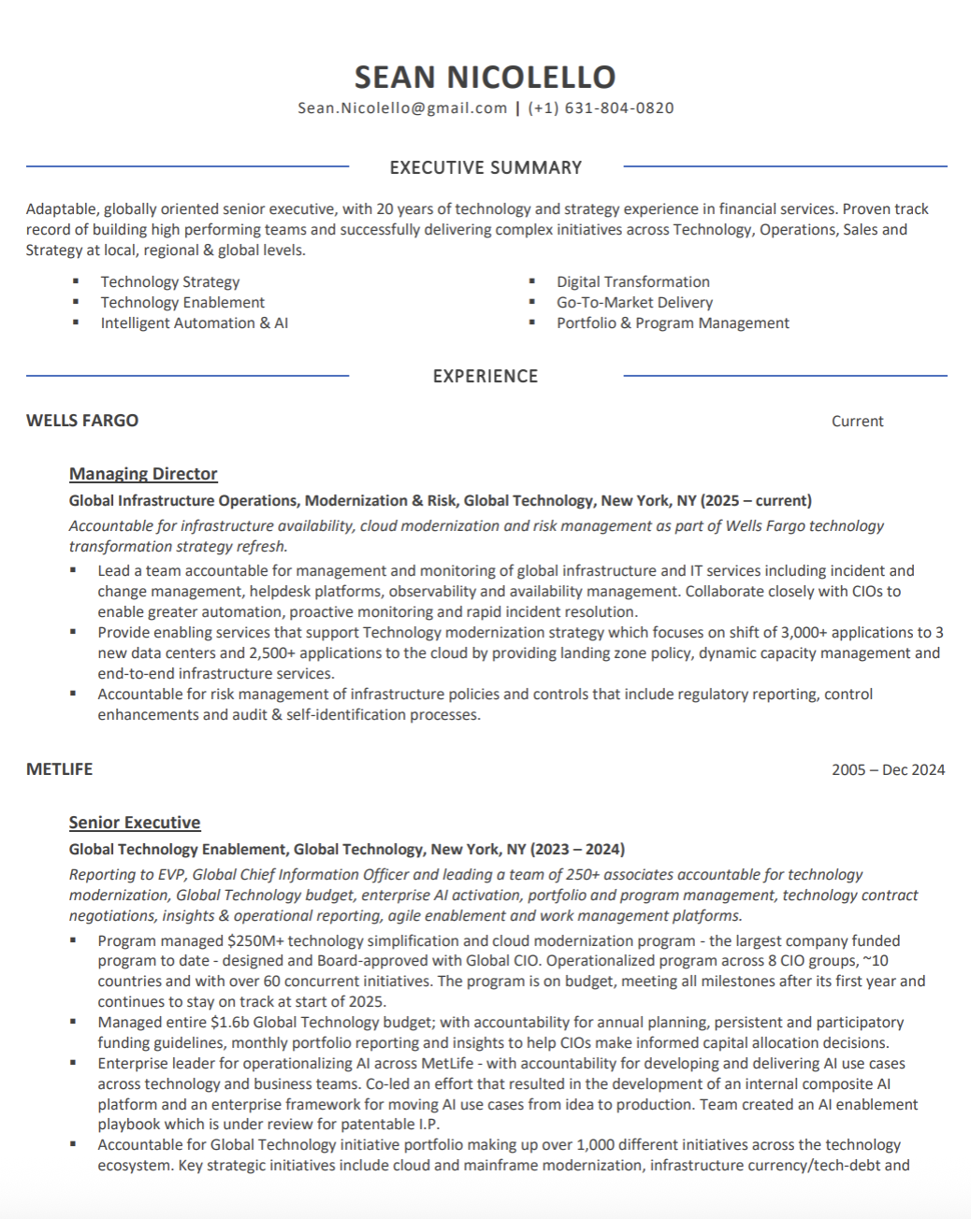
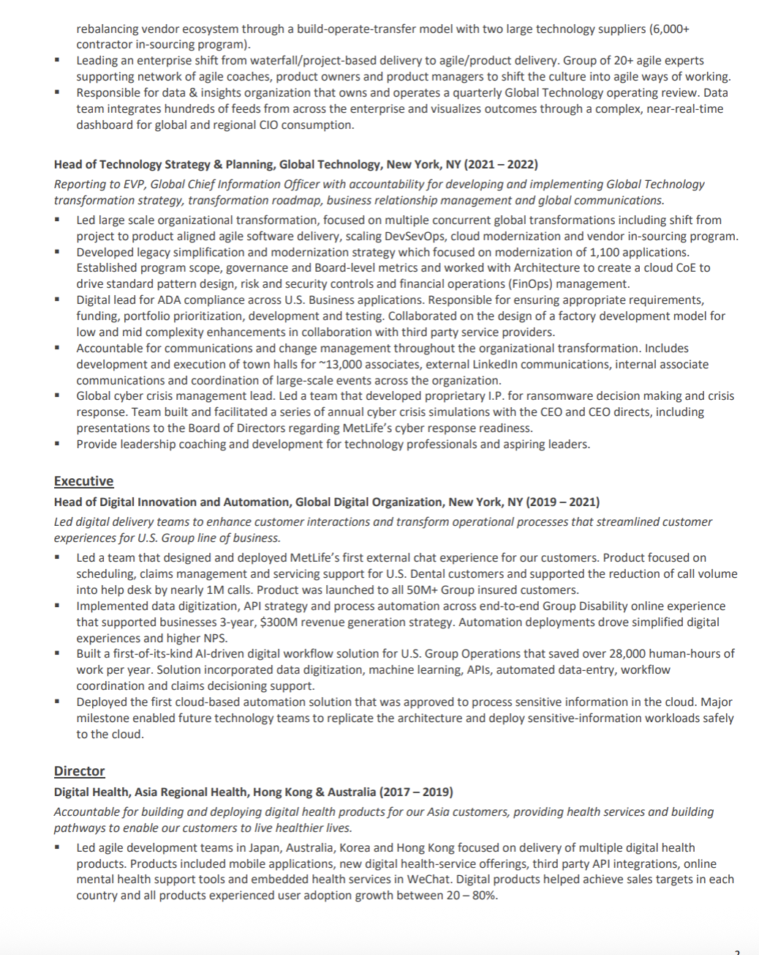
THE EVIDENCE MOSAIC
/DEFINE
/ASSESS
/MOBILIZE
RESUME / CV
Assess the successor’s external experience to identify:
Roles/responsibilities that fill gaps in experience with this organization
Additional experience related to JTBDs for the role
Mark Nicole

Slide 38
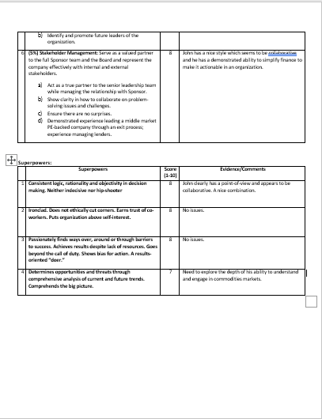
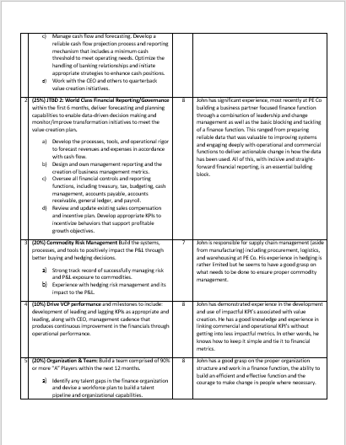
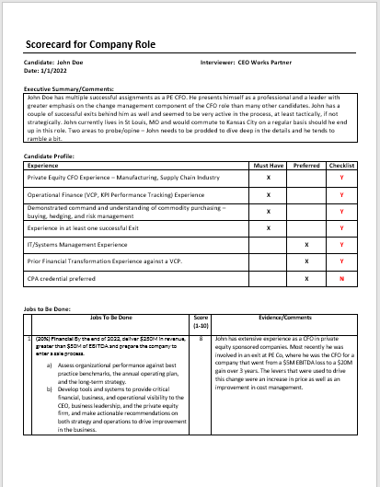
THE EVIDENCE MOSAIC
/DEFINE
/ASSESS
/MOBILIZE
STAKEHOLDER PERSPECTIVES AND CALIBRATIONS
Identify successor’s alignment with the role’s JTBD and Superpowers
Calibrate and discuss varied Stakeholders' views in key leadership areas
Focus on understanding the gaps – identifying where the successor does not have experience and asking questions about related activities

Slide 39
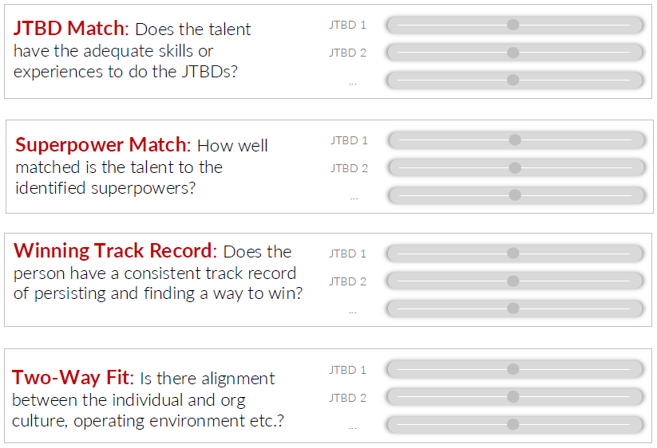
THE EVIDENCE MOSAIC
/DEFINE
/ASSESS
/MOBILIZE
RISK ASSESSMENT
Identify and assess talent risks based on:
JTBD match
Superpower match
Winning track record
Two-way fit

Slide 40
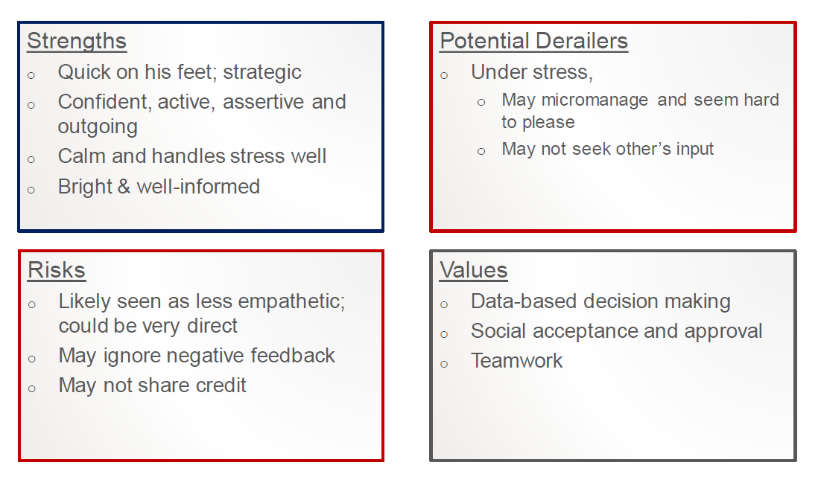
THE EVIDENCE MOSAIC
/DEFINE
/ASSESS
/MOBILIZE
PSYCHOMETRIC ASSESSMENT
Compare findings from the Hogan assessment to the future Jobs to be Done for the role
Identify strengths and weaknesses against the role requirements
Identify potential derailers against the future JTBD and role/work challenges

Slide 41
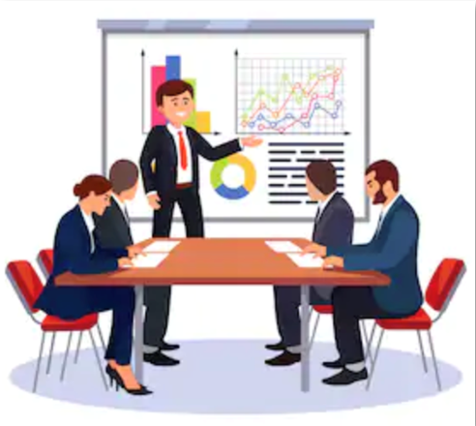
THE EVIDENCE MOSAIC
/DEFINE
/ASSESS
/MOBILIZE
ENGAGEMENT SURVEYS
Provide insights into the morale and engagement of the successor’s direct reports and downstream employees
Project any trends and tendencies to the next role’s organization

Slide 42
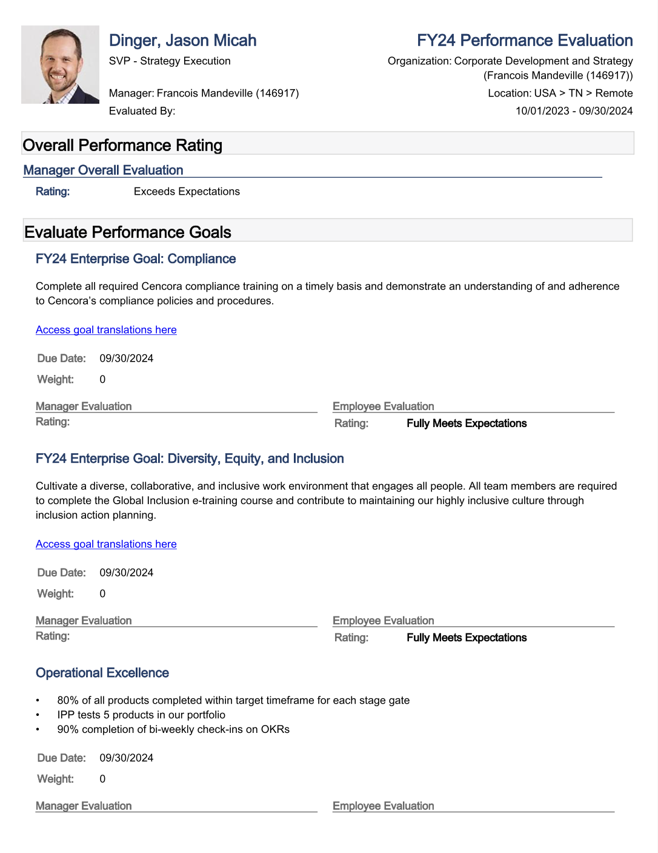
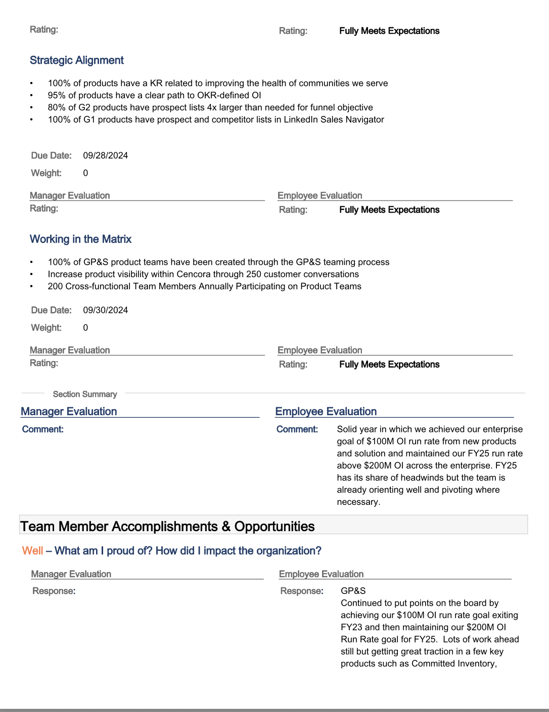
THE EVIDENCE MOSAIC
/DEFINE
/ASSESS
/MOBILIZE
PERFORMANCE REVIEWS
Assess the successor’s past performance to identify:
Experience related to JTBDs
Gaps in experience
Weaknesses in past performance that could show up in the future role
Mark Nicole

Slide 43
Assess succession readiness example
/DEFINE
/ASSESS
/MOBILIZE
Target Role: Head of Digital Solutions & Data
KEY TALENT INSIGHTS
Marcus Chen
Head of Product & Data Commercialization
Ready with development
Talent Match
Development Needs
Jobs To Be Done |  |  | Readiness
1 | 30% | Continuous Improvement of Infrastructure
2 | 35% | Digital Transformation of Core Processes
3 | 15% | Digital Innovation for New Products, Services, and Revenue Streams
4 | 20% | Major Platform & Technology Upgrade
Commercial technologist — Sponsored app rationalization and payments stabilization that protected revenue and improved KPIs.
Trusted integrator — Convened Product, Engineering, Ops and Country teams to deliver launch‑ready offerings.
Pilot-to-scale operator — Incubated a fintech product and scaled it to national SuperApp rollout under P&L.
Delivery credibility — Led major releases and post‑launch stabilization with measurable MTTR and capacity gains.
Platform fluency — Gain hands‑on leadership in cloud‑native, high‑concurrency platform modernizations (payments, identity, MLOps).
AI commercialization — Build repeatable playbooks for multi‑market AI/LLM consumer product launches.
Scale commercialization — Convert pilots into P&L-driven, repeatable products with standardized GTM and pricing evidence.
Executive storytelling — Tighten board‑grade narratives linking tech tradeoffs to revenue to secure funding.
Superpowers
1 | Outstanding collaborator with business leaders, providing expert advice to impact commercial and operational goals.
2 | Continuously improving digital infrastructure and data quality, while driving future-focused digital products, services, and innovation leading to business growth
Key Questions
Will he be able to lead and influence technical platform projects for enterprise impact?
Can he convert pilots into go-to-market results and repeatable outcomes?
●
●
Readiness Scale
●
●
●
Not Ready
Ready

Slide 44
Marcus Chen - Head of Product & Data Commercialization
Target Role: Head of Digital Solutions & Data
/DEFINE
/ASSESS
/MOBILIZE
Job to Be Done Readiness |  |  |  | Evidence
1 | 30% | Continuous Improvement of Infrastructure |  | Led FrontierDigitalCo’s application rationalization (consolidated ~3,700 services), reducing ops overhead and simplifying compliance. Owned incident response and customer communications during a major payments disruption, shortening MTTR and stabilizing customer impact.
2 | 35% | Digital Transformation of Core Processes |  | Orchestrated cross‑market onboarding and merchant activation rework, cutting onboarding time ~60% and delivering ~$350M equivalent operational savings. Ran post-launch stabilization and continuous improvement cadence across multiple countries.
3 | 15% | Digital Innovation for New Products, Services, and Revenue Streams |  | Sponsored an internal incubator that launched a localized fintech product within the SuperApp and scaled it to national rollout under the candidate’s P&L oversight. Led incubation and first‑market scaling for AI-driven features but has limited multi‑market AI product launch track record.
4 | 20% | Major Platform & Technology Upgrade |  | Led complex platform upgrades (billing, payments components, major SuperApp releases) and integrations with country systems. Needs to demonstrate recent, hands-on leadership of cloud-native, high-concurrency modernizations (payments hub, identity at 100M+ scale).
Superpowers Readiness |  |  | Evidence
1 | Outstanding collaborator with business leaders, providing expert advice to impact commercial and operational goals. |  | Built data-driven business cases and roadmaps that secured executive sponsorship for multi-year digital investments. Partnered with country leaders and regulators to drive platform adoption and operational change.
2 | Continuously improving digital infrastructure and data quality, while driving future-focused digital products, services, and innovation leading to business growth |  | Guided platform security and data-governance modernization across multiple markets. Owned large transformation workstreams end-to-end, showing operational rigor and product focus.
●
●
Readiness Scale
●
●
●
Not Ready
Ready

Slide 45
Creating a succession pipeline
/DEFINE
/ASSESS
/MOBILIZE
Ready now
Ready with development
Not ready

Slide 46
Successor slate
/DEFINE
/ASSESS
/MOBILIZE
Head of Digital Solutions & Data
Sofia Alvarez
Marcus Chen
Priya Nair
Senior Director, Digital Platforms & Integration
Head of Product & Data Commercialization
Director, Digital Transformation and Launches
Readiness Assessment
Readiness
Readiness
Readiness
1
30%
Continuous Improvement of Infrastructure
2
30%
Digital Transformation of Core Processes
3
20%
Digital Innovation for New Products, Services, and Revenue Streams
4
10%
Major Platform & Technology Upgrade
SP1
Outstanding collaborator with business leaders, providing expert advice to impact commercial and operational goals.
SP2
Continuously improving digital infrastructure and data quality, while driving future-focused digital products, services, and innovation leading to business growth
Ready Now
Ready with development
Not ready

Slide 47



/ASSESS SUMMARY
/DEFINE
/ASSESS
/MOBILIZE
Key Points
Successors should be evaluated using an evidence mosaic to ensure the best candidate for the future role is selected
Rigorous, muti-point, evidence-based comparison of candidate slate will drive recommendation and trade-offs across the slate (Be Risk-Seeking)
Succession assessments are about determining the candidate who’s most likely to deliver the future JTBDs

Slide 48
Succession To Value™
/MOBILIZE

Slide 49
Succession to value™ methodology
/DEFINE
/ASSESS
/MOBILIZE
/DEFINE
/ASSESS
/MOBILIZE
What needs to be true in the future for the role to succeed?
Are successors ready for the job? How ready are they?
How do we prepare and support the successor?
Outputs:
Future Jobs to be Done
Risk Assessment
Superpowers
Outputs:
Multi-point Evidence Mosaic
Readiness Summary
Pipeline Health Snapshot
Outputs:
Development Plan
Notes:
Swap icons w/16

Slide 50


Closing the gap
/DEFINE
/ASSESS
/MOBILIZE
Focus on those who are “ready with development”– what is the plan to address their identified gaps?
What roles, responsibilities, experiences, or capabilities can bridge the gap?
Monitor and adjust plan as needed to ensure succession readiness.
Current skills & experience
Requirements for future role

Slide 51
Succession interventions: closing the gap
/DEFINE
/ASSESS
/MOBILIZE
Goal
Address gaps to prepare successors for the JTBDs in the future
Now
Next
Later
(0–12 months)
(12-24 months)
(24+ months)
Stretch and develop them in their current job
Sequenced actions to prepare them for the future
Notes:
Review formatting

Slide 52
Example - development plan
/DEFINE
/ASSESS
/MOBILIZE
Marcus Chen
Head of Product & Data Commercialization
Signature Strength
A business-first digital leader who converts technical programs into commercial readiness and earns cross‑functional trust to de‑risk launches and scale validated products.
Opportunities for Continued Growth
Deepen platform architecture fluency
Strengthen market-access pricing and seller evidence
Scale MVPs to P&L
Amplify executive presence
Development Focus | Actions
Platform fluency | Shadow the Enterprise Architecture team during a platform sprint and attend vendor/cloud workshops. Complete an executive cloud/architecture short course and deliver a one‑page decision memo for an upcoming migration.
Market‑access & pricing basics | Co-sponsor one value-based pricing pilot with Market Access; own the topline model and seller brief. Run two payer/partner briefing rehearsals to tighten the evidence narrative and objection handling.
NOW
(0–12 months)
Development Focus | Actions
Scale commercialization & P&L ownership | Convert one validated pilot into a repeatable, multi‑region product (GTM package, P&L, sales incentives, SLAs). Own quarterly P&L reviews and present the scale plan to the Executive Committee.
Advanced market‑access & pricing capability | Complete market-access immersion and a payer simulation; roll out a pricing playbook for the scaled product. Establish simple elasticity and willingness‑to‑pay tests in two markets to refine pricing tiers.
Amplify Executive presence | Work with executive coach on improving executive and c-suite communication for impact Present a strategic commercialization review to Exec Committee/Board; solicit stakeholder feedback and adjust communication as needed
NEXT
&
LATER
(12–36 months)
Notes:
Review formatting

Slide 53

Driving the role to deliver the value
/DEFINE
/ASSESS
/MOBILIZE
The Succession Development Plan includes:
Activities that are tailored for specific successor
Consider what about the role will be new or difficult for the successor based on their experience
Interventions put in place to mitigate risks
Doing all we can to prepare the successor to deliver value in the future role
Notes:
Replace w/summary points from Ming’s comment

Slide 54
Activity: succession development plan
/DEFINE
/ASSESS
/MOBILIZE
Review the candidate assessment result for Sarah for the VP of Digital Marketing and Growth role.
What gaps exist between Sarah and the future role? What should be her development focus?
Identify activities to close those gaps. When should these activities be done for her to have continued growth?

Slide 55
Assess succession readiness example
/DEFINE
/ASSESS
/MOBILIZE
Target Role: VP of Digital Marketing and Growth
KEY TALENT INSIGHTS
Sarah Hogwen
Regional Marketing Director
Ready with development
Talent Match
Development Needs
Future Jobs To Be Done |  |  | Readiness
1 | 30% | Maximize multiplay economics and push toward saturation
2 | 25% | Transition from MAU growth to engagement depth and monetization
3 | 20% | Scale AI from pilot success to pervasive commercial capability
4 | 15% | Evolve from efficiency optimization to predictive growth investment
5 | 10% | Transform marketing organization from execution engine to strategic growth partner
Commercial integrator: strong record converting pilots to scaled regional launches with measurable ARPU and churn improvements (maps to green readiness on multiplay & engagement).
Conversion and growth execution: proven at driving DAU/MAU, bundle adoption, and retention gains that materially move revenue levers.
AI commercialization: secure ownership of MLOps and multi‑market AI rollout capability, including localization and measurement frameworks, to move AI readiness from orange to green.
Predictive investment & org scaling: evolve dynamic budget allocation to reach ≥20% experimental allocation with predictive ROI gating
Transform marketing function - build a stronger marketing organization, including an ability to hire and grow talent with the right capabilities to become a strategic partner to the business.
Superpowers
1 | Trusted integrator: Rapidly translating commercial priorities into prioritized, time‑boxed deliverables and securing decision rights and funding
2 | Pilot‑to‑scale operator: Converting pilots into repeatable, measurable products with clear unit economics, GTM playbooks, and P&L ownership—demonstrating quick wins
Key Questions
Can Sarah lead cloud‑specific projects that have enterprise impact?
Can she demonstrate ownership and create followership for AI commercial projects?
●
●
Readiness Scale
●
●
●
Not Ready
Ready

Slide 56
Assess succession readiness example
/DEFINE
/ASSESS
/MOBILIZE
Sarah Hogwen - Regional Marketing Director
Target Role: VP of Digital Marketing and Growth
Job to Be Done Readiness |  |  |  | Evidence
1 | 30% | Maximize multiplay economics and push toward saturation |  | Ran a regional bundling program across three countries, raising services/customer 2.8→3.4 and regional multiplay ARPU ~18% YoY. Launched a targeted churn intervention that cut bundle churn ~22% and delivered measurable incremental ARPU.
2 | 25% | Transition from MAU growth to engagement depth and monetization |  | Reallocated spend to retention/reactivation, lifting DAU/MAU 36%→46% and revenue/MAU ~20% in 12 months. Scaled cross‑vertical journeys that increased second‑service conversion ~30% and organic share of new MAUs to ~55%.
3 | 20% | Scale AI from pilot success to pervasive commercial capability |  | Piloted a recommendation engine and AI chat in one market, improving onboarding conversion 12% and trial→paid conversion 18% in pilots. Gap: limited proof of her ability to scale multi‑market MLOps ownership.
4 | 15% | Evolve from efficiency optimization to predictive growth investment |  | Built regional attribution and A/B framework, shortening time‑to‑scale for winners from ~5 to ~3 months. Gap: lacks the ability to build and deploy a predictive ROI system for efficiency improvements (currently episodic)
5 | 10% | Transform marketing organization from execution engine to strategic growth partner |  | Created a regional growth function and GTM playbooks adopted in two countries. Gap: Demonstrate ability to hire and develop senior leaders and create a viable succession plan for her role
Superpowers Readiness |  |  | Evidence
1 | Trusted integrator: Rapidly translating commercial priorities into prioritized, time‑boxed deliverables and securing decision rights and funding |  | Convened Product, Engineering, Ops, and Country leads to deliver bundle launches and secure executive sponsorship. Engaged regulators and market leaders early, preventing rework and enabling smoother rollouts.
2 | Pilot‑to‑scale operator: Converting pilots into repeatable, measurable products with clear unit economics, GTM playbooks, and P&L ownership—demonstrating quick wins |  | Incubated a fintech pilot, owned initial P&L, and scaled to 450K active accounts in 9 months; codified GTM templates for follow‑on launches.
●
●
Readiness Scale
●
●
●
Not Ready
Ready

Slide 57
Development plan
/DEFINE
/ASSESS
/MOBILIZE
Sarah Hogwen
Regional Marketing Director
Signature Strength
Opportunities for Continued Growth
Development Focus | Actions
NOW
(0–12 months)
Development Focus | Actions
NEXT
&
LATER
(12–36 months)
Notes:
Review formatting

Slide 58
Development plan - answer key
/DEFINE
/ASSESS
/MOBILIZE
Sarah Hogwen
Regional Marketing Director
Signature Strength
A commercial, product‑focused growth leader who converts pilots into repeatable GTM packages, secures cross‑functional sponsorship, and delivers measurable ARPU and churn improvements.
Opportunities for Continued Growth
Deepen cloud‑native platform fluency (payments, identity, MLOps) and scale AI commercialization across markets.
Convert pilots to P&L‑driven repeatable products.
Strengthen the team
Development Focus | Actions
Marketing Team Readiness | Partner with HR BP to assess the current team, identifying gaps to acquire needed capabilities
Scale commercialization & P&L ownership | Convert a validated pilot into a repeatable multi‑market product with GTM pack (pricing, onboarding, incentives, SLAs); lead quarterly P&L reviews.
NOW
(0–12 months)
Development Focus | Actions
AI commercialization & MLOps ownership | Sponsor transfer of an AI pilot to market ownership (localization, monitoring, rollback, KPI linkage) and build a replication playbook.
Scale commercialization & P&L ownership | Convert a validated pilot into a repeatable multi‑market product with GTM pack (pricing, onboarding, incentives, SLAs); lead quarterly P&L reviews.
Bench building | Mentor and sponsor one senior regional candidate into product/commercial readiness (viable succession plan).
NEXT
&
LATER
(12–36 months)
Notes:
Review formatting

Slide 59
Wrap-Up

Slide 60
Summary & what’s next?
You should now be able to:
Explain the differences between the T2V Succession Planning process and traditional approaches
Identify future-focused Jobs to be Done for key roles to assist in selecting the best successors
Complete a risk assessment and identify superpowers needed to deliver value from critical roles
Prepare outputs (succession readiness assessment, role health snapshots, externally-benchmarked readiness assessments, Hogan report) to assist with successor selection
Build targeted development plans
Implement what you have learned today with your next Succession Planning activity.

Slide 61
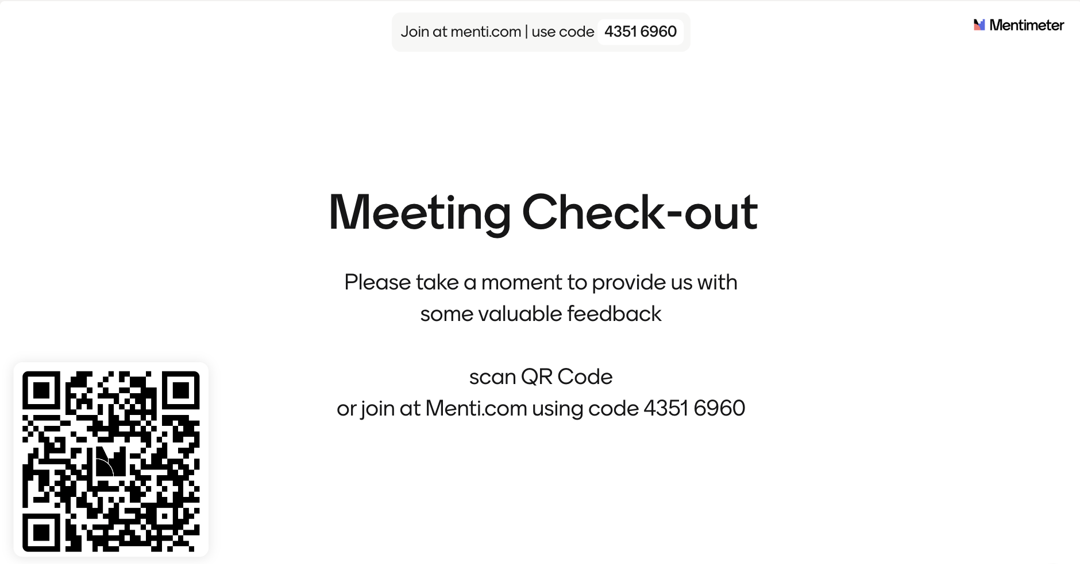
Feedback survey

Slide 62
Q&A

Slide 63
/answer key – jtbd
VP of digital marketing & growth
# | Wt% | Outcome | Priority Work
1 | 30% | Maximize multiplay economics and push toward saturation | What: Shift from building multiplay to maximizing yield and penetration. How: Refine segmentation, evolve bundles, deploy predictive churn interventions, and test next‑gen bundle constructs. How much: Multiplay penetration 45%→55%+; services/customer 3.5→4.0+; multiplay churn −20%; incremental ARPU >$450M. By when: 31 Dec 2028.
2 | 25% | Transition from MAU growth to engagement depth and monetization | What: Pivot from acquisition to deeper engagement and higher monetization. How: Reallocate spend to retention/reactivation; build cross‑vertical journeys, premium tiers, and viral growth loops. How much: DAU/MAU 40%→50%+; revenue/MAU +25%+; 60%+ new MAUs organic; digital‑only churn −30%. By when: 31 Dec 2028.
3 | 20% | Scale AI from pilot success to pervasive commercial capability | What: Make AI the default personalization and product engine across journeys. How: Move to always‑on AI integration, operationalize MLOps/closed‑loop learning, expand local LLMs, and launch AI‑native products. How much: AI‑influenced revenue 15%→40%+; AI in 100% of journeys; 2x conversion lift; 3+ AI products per market. By when: 31 Dec 2029.
4 | 15% | Evolve from efficiency optimization to predictive growth investment | What: Shift from reactive efficiency to predictive investment allocation. How: Build predictive ROI models, dynamic budget allocation, leading‑indicator dashboards, and a test‑and‑scale framework. How much: 90%+ pre‑launch ROI accuracy; time‑to‑scale 6 months→6 weeks; ≥20% budget for predictive/experimental bets. By when: 31 Dec 2027.
5 | 10% | Transform marketing organization from execution engine to strategic growth partner | What: Elevate marketing into the commercial voice shaping product, pricing, and expansion. How: Embed growth leaders in product/vertical teams, build hybrid talent, and deliver a single customer‑intelligence platform. How much: Marketing drives 30%+ of roadmap decisions; growth leaders as GM/country succession; single source of customer truth. By when: 31 Dec 2028.
Notes:
The CDIO Example

